Slide 1
OSNOVE poslovne angleščine
Avtorica: Emili Novak
2., 3. in 4. 7. 2024

Slide 2
O meni
diplomirana prevajalka (hrvaščina, angleščina in slovenščina) in filozofinja
prevajanje, lektoriranje in učenje jezika
poslovna angleščina in hrvaščina
branje

Slide 3
Basics – greetings, introducing… (Osnove - pozdravi, predstavljanje...)
What’s your name?
My name is…
I am…
How are you?
How you doing?
What’s up! (kako gre, kaj dogaja?)
Can you repeat that?
I am sorry, I didn’t catch it… nisem vas razumela, nisem te slišala)
What’s that…? – Kako …?
Hello!
Hi!
Hey!
Good morning!
Good evening!
Good night!
Bye!
(It was) nice to meet you!

Slide 4
Grammar (Slovnica)
PARTS OF SPEECH: Samostalnik, glagol, pridevnik, prislov, predlog, veznik – Noun, Verb, Adjective, Adverb, Preposition, Conjunction (da lahko oblikujemo jasne in jedrnate stavke)
TENSES: sedanjost, preteklost, prihodnost – Present, Past, Future

Slide 5
Tenses (Časi)
PRESENT: (is, has – to be, to have)
I am Emili/I love butterflies. I have sister. Sun shines. – present simple
I am doing my homework. I am eating my lunch. – present con.
FUTURE: (will, would, going to)
I will go now. – future s. (KOT present s.)
I will be working tomorrow morning. – future con. (KOT present con.)
I am going to bed earlier. (early)
Past: (was, had)
I gave her a present. – past simple
I was giving her a present.

Slide 6
Passive and active voice (trpnik in tvornik)
The agent performing the action is obvious, unimportant, or unknown or when a writer wishes to postpone mentioning the agent until. (očiten, nepomemben ali neznan)
The product was made.
Workers made product.
The letter was written by her.
She wrote the letter.

Slide 7
Vocabulary (words and phrases) (Besedišče (besede in fraze))
meeting - srečanje
(to take) minutes – sestaviti/pisati zapisnik
agenda – dnevni red
discussion - razprava
(put it to a) vote - glasovanje
summary - povzetek
report - poročilo
urgent - nujno
second opinion
suggestion
Recent – nedavno
chairperson – predsednik/-ca
to sum up - povzeti
conclusion
customer survey - anketa med strankami
to look at - pogledati
to outline - opisati
move on – premakniti se naprej
to recommend – predlagati
to summarize - povzeti
to expand - razširiti
to improve - izboljšati
to provide - zagotoviti
to suggest

Slide 9
Business letters and e-mails (Poslovni dopisi in e-pošta)
Opening: mailing address, the full date (July 30, 2017), recipient’s name, company, and address. (skip one line between your address, the date, and your recipient’s information – kot v slovenščini)
Salutation: “Dear,” along with their title and last name - “Dear Mr. Collins” - full name - “Dear Taylor Dean.” (be sure to add a colon (dvopičje) to the end of the salutation)
Body: introduce yourself and the main point of your letter, - go into the details of your main point, - restate the letter’s purpose; provide a call to action.

Slide 10
Na začetku: poštni naslov, polni datum (30. julij 2017), ime prejemnika, podjetje in naslov (med naslovom, datumom in podatki o prejemniku preskočite eno vrstico - kot v slovenščini).
Pozdrav: "Spoštovani" skupaj z naslovom in priimkom - "Spoštovani gospod Collins" - polno ime - "Spoštovani Taylor Dean". (na koncu pozdrava obvezno dodajte dvopičje)
Vsebina: predstavite sebe in glavno točko pisma,- podrobneje predstavite glavno točko,- ponovite namen pisma; navedite poziv k ukrepanju.

Slide 11
Closing: “Sincerely” or “Yours truly” -“Cordially” or “Best regards/Best wishes.” (add a comma to the end of it)
Signature: Skip four lines after the closing – your name, your job title and company name, - hard copy, sign your name in the empty space using blue or black ink.
Enclosures (priloge): documents with this letter - list them here.

Slide 12
Zaključek: "Iskreno" ali "Resnično" - "Prisrčno" ali "Lep pozdrav/najboljše želje". (na koncu dodajte vejico)
Podpis: na koncu podpišite štiri vrstice - svoje ime, naziv delovnega mesta in ime podjetja, - v tiskani obliki se na prazno mesto podpišite z modrim ali črnim črnilom.
Priloge: dokumenti, priloženi temu dopisu - navedite jih tukaj.

Slide 13
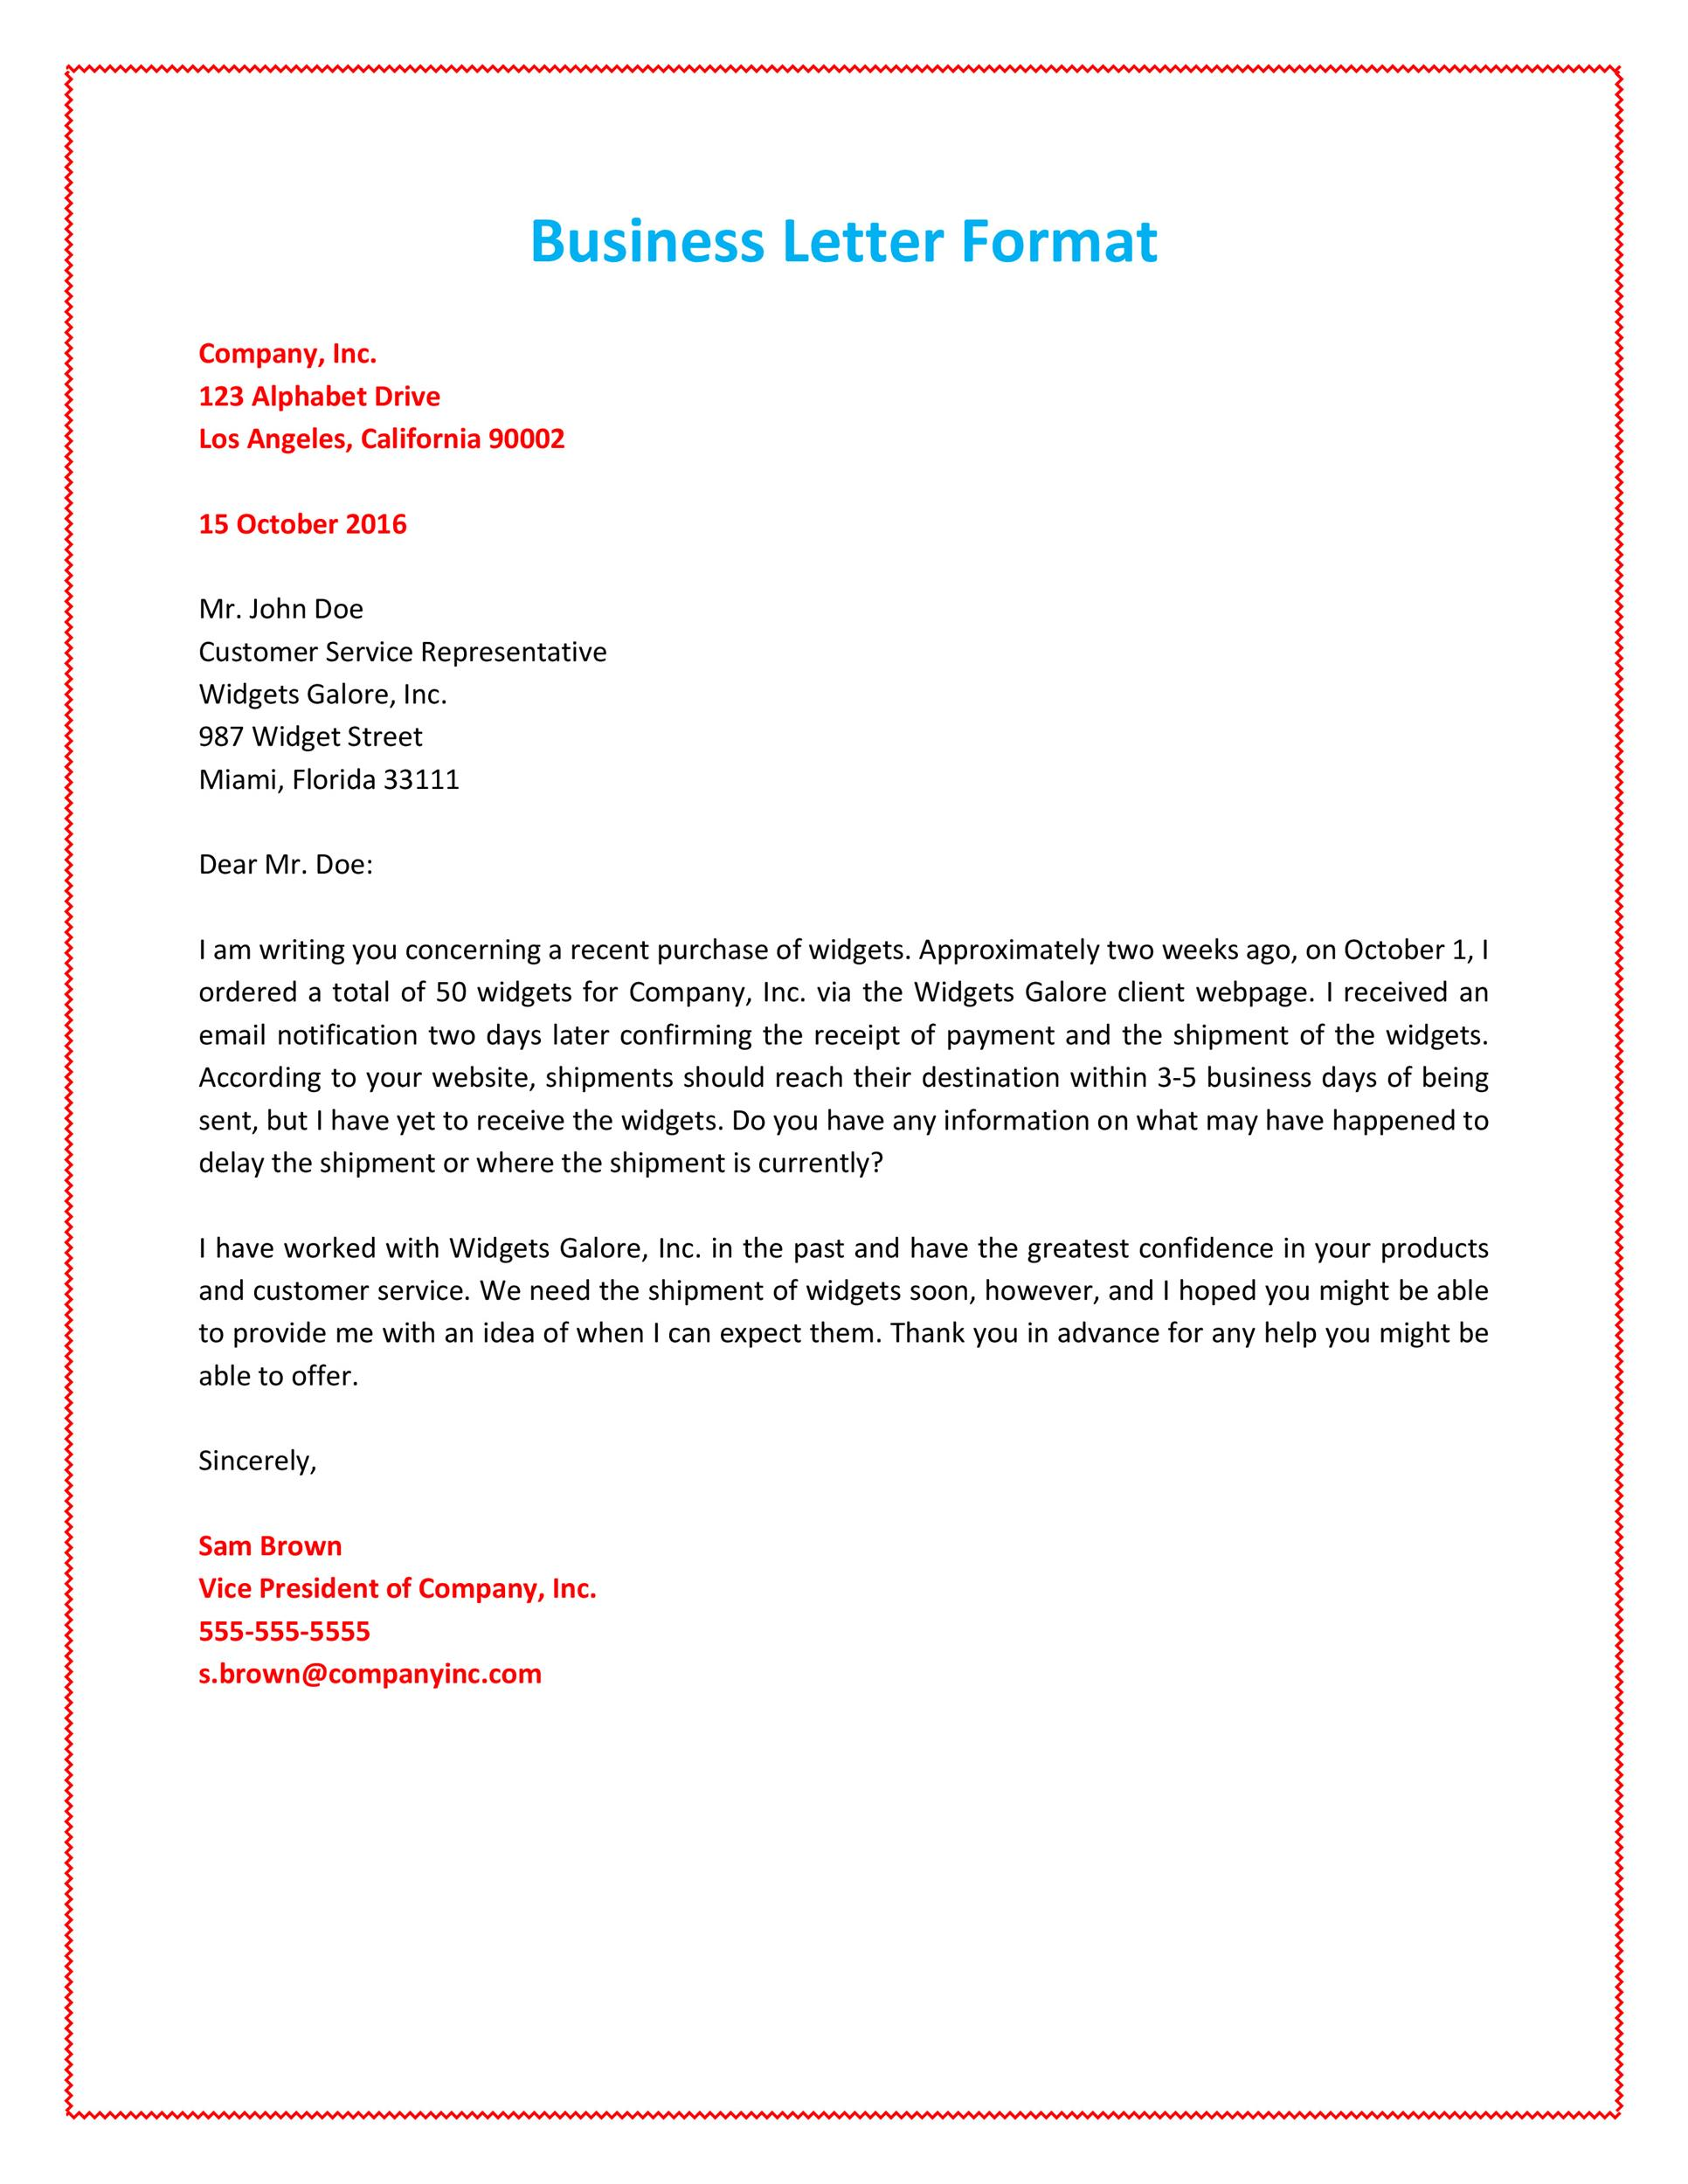

Slide 14
E-mails (e-pošta)
subject line – predmetna vrstica
formal greeting – uradni pozdrav
body copy – besedilo vsebine
closing phrase – zaključni stavek
signature – podpis

Slide 17
Phone calls (Telefonski klici)
prepare - write down the key points you need to cover (pripravite, pripravite se)
identify yourself - give your, last name, your title if applicable (ime, priimek in naziv)
identify purpose - state the purpose politely and directly (vljudno in neposredno )
take time to listen - two-sided conversation; give time to respond to your points and ask any questions they may have; be careful not to interrupt (dvostranski pogovor)
review call - review what was accomplished during the call (ponovite)

Slide 18
pripravite se - zapišite si ključne točke, ki jih morate obravnavati.
se predstavite - navedite svoje ime, priimek in po potrebi naziv
opredelite namen - vljudno in neposredno navedite namen
vzemite si čas za poslušanje - dvostranski pogovor; dajte jim čas, da se odzovejo na vaše točke in postavijo morebitna vprašanja - pazite, da jih ne prekinete
pregled klica - preglejte, kaj je bilo doseženo med klicem

Slide 19
Phrases for calls (Fraze za klice)
Hello, this is [Your Name] from [Your Company].
I’m calling about [specific topic or issue]. – Kličem vas, ker … Kličem vas zaradi…
[Your Name] speaking. How may I help you today? – Kako vam lahko pomagam
Thank you for calling [Your Company Name]. This is [Your Name].
Could you specify which [product/service/issue] you’re referring to? – Ali lahko natančno navedete, na kateri izedelek se nanašate?
I’d appreciate it if you could send that information in writing as well.
– Prosil bi, če bi mi te informacije poslali tudi v pisni obliki.

Slide 20
To recap, we’ve decided to... –Če povzamemo, smo se odločili, da …
Just to confirm, we’re in agreement on… – Samo v potrditev, da se strinjamo glede...
Can you hear me clearly? I’m experiencing some connection issues. – Ali me dobro slišite?
Sorry, I missed your last point. Could you repeat that? – Preslišal/a sem; ponovite) Ali lahko ponovite?
Thank you for your time today. I appreciate the insights.
It was great speaking with you. Let’s touch base again soon.
– Zahvaljujem se vam za vaš današnji čas. Cenim vaša opažanja.
– Lepo je bilo govoriti z vami. Kmalu se spet povežemo.

Slide 21
Verbal nods (Verbalno prikimavanje)
Uh-huh
Sounds interesting
Good
Yes, I understand
That’s right
I see
Could you please tell me more about [topic]
Uh-huh
Zveni zanimivo
Prav.
Da, razumem
Tako je prav
Razumem
Ali mi lahko poveste več o [tema]

Slide 22
Meetings (Sestanki)
Opening meeting
- Welcome to the meeting! - I appreciate your presence and active participation in today's meeting. Let's begin by - As we start, I'd like to remind everyone that our main goal for today's meeting is… - Good [morning/afternoon], everyone. Let's start off with…

Slide 23
Uvod
- Dobrodošli na sestanku! - Cenim vašo prisotnost in aktivno udeležbo na današnjem sestanku. Začnimo z… - Na začetku bi rad vse spomnil, da je naš glavni cilj današnjega srečanja... - Dobro [jutro/popoldne] vsem. Začnimo z...

Slide 24
Phrases for presenting the meeting goals
- Our aim today is to…
- We are here today to decide on/agree on, etc.
- The purpose of today’s meeting is…
- Today, we are going to…

Slide 25
Fraze za predstavitev ciljev sestanka
- Naš današnji cilj je...
- Danes smo se zbrali, da se odločimo/ dogovorimo o itd.
- Namen današnjega sestanka je...
- Danes bomo...

Slide 26
Phrases for moving to another topic
- Let’s move on to our next point.
- If nobody has anything else to share, let’s move on to…
- Since we’ve covered this issue, now we can go to the next one.
- Now that we’ve found a solution/finished discussing this topic, we can go to…

Slide 27
Fraze za prehod na drugo temo
- Preidimo na naslednjo točko.
- Če nima nihče ničesar več za povedati, nadaljujmo z...
- Ker smo to vprašanje obravnavali, lahko zdaj nadaljujemo z naslednjim.
- Zdaj, ko smo našli rešitev/končali razpravo o tej temi, lahko gremo na...

Slide 28
Phrases for summarizing
- To sum up, we’ve talked about…
- Let’s quickly summarize the main points of today’s meeting.
- Here are some of the main points we discussed today.
- Before we finish, let’s go over everything we talked about today.

Slide 29
Fraze za povzemanje
Če povzamemo, govorili smo o...
- Na hitro povzemimo glavne točke današnjega sestanka.
- Tukaj je nekaj glavnih točk, o katerih smo se danes pogovarjali.
- Preden zaključimo, ponovimo vse, o čemer smo se danes pogovarjali.

Slide 30
Making appointments (Dogovarjanje sestankov)
Arranging
I would like an appointment with Mr/Ms_____ please.
When would it suit you?
Can we arrange a meeting?
I think we should meet.

Slide 31
Organiziranje
Želim se dogovoriti za sestanek z gospodom/gospo_____.
Kdaj bi vam to ustrezalo?
Ali se lahko dogovorimo za sestanek?
Mislim, da bi se morala srečati.

Slide 32
Postponing
I wonder whether we can postpone our meeting?
I can't make it tomorrow at __. Can we make it a bit later, say ___?
Would it be possible to set another date?
I have to postpone our meeting until…
Unfortunately I am double booked on the day we arranged to meet. Would it be possible to make another date?
I am forced to change the date of our meeting.
Could we make it a bit earlier/later?

Slide 33
Prestavljanje
Zanima me, ali lahko sestanek prestavimo?
Jutri ob __ ne morem priti. Ali se lahko dobimo malo pozneje, recimo ___?
Ali bi bilo mogoče določiti drug datum?
Najino srečanje moram prestaviti do...
Žal sem na dan, za katerega sva se dogovorila za srečanje, dvojno zaseden. Ali bi bilo mogoče določiti drug datum?
Prisiljena sem spremeniti datum najinega srečanja.
Ali bi se lahko srečali malo prej ali pozneje?

Slide 34
Cancelling
Owing to…, I'm afraid I have to cancel our appointment.
I'm afraid I have to cancel our appointment for tomorrow.
Regretfully, I have to inform you that I will not be able to attend our proposed meeting, and shall therefore have to cancel.
I could not reach you on the phone, so I am writing you this mail to tell you I have to cancel your appointment for tomorrow.

Slide 35
Odpovedovanje
Zaradi... se bojim, da moram odpovedati najin sestanek.
Bojim se, da moram odpovedati najin jutrišnji sestanek.
Na žalost vas moram obvestiti, da se najinega predlaganega srečanja ne bom mogel udeležiti, zato ga bom moral odpovedati.
Po telefonu vas nisem mogel priklicati, zato vam pišem to pošto in vam sporočam, da moram odpovedati najin sestanek za jutri.

Slide 36
Informal style
Would you be free on (the afternoon) of (the ___th) at…
We need to discuss….and it will take a couple of hours. Would you be available on…at…?
How about meeting at my office at about 12.3o?
Look forward to it. See you on the (…) at (…)

Slide 37
Neuradni slog
Ali bi bili prosti (popoldne) dne (___tega) ob...
Pogovoriti se moramo....in to bo trajalo nekaj ur. Ali bi bili na
voljo ... ob ...?
Kaj če bi se srečali v moji pisarni okoli 12.30?
Veselim se. Se vidimo (...) ob (...)

Slide 38
Presentations (Predstavitve)
Introduction
Good morning/afternoon everyone and welcome to my presentation. Let me start by saying a few words about my own background.
(POZDRAV in potem…) As you can see on the screen, our topic today is...
My talk is particularly relevant to those of you who...
This morning/ afternoon I’m going to take a look at the…

Slide 39
Uvod
Dobro jutro/dober dan vsem in dobrodošli na moji predstavitvi. Na začetku naj povem nekaj besed o sebi.
Kot lahko vidite na zaslonu, je naša današnja tema...
Moje predavanje je še posebej pomembno za tiste, ki...
Danes zjutraj/danes si bom ogledali...

Slide 40
Introducing the topic
Today I am here to talk to you about…
What I am going to talk about today is…
I would like to take this opportunity to talk to you about…
I want to make you a short presentation about…
I’d like to give you a brief breakdown of…

Slide 41
Uvajanje v temo
Danes vam bom govorila o...
O čem se bom danes pogovarjal, je...
To priložnost bi rada izkoristila za pogovor o...
Rad bi vam na kratko predstavil...
Želim vam kratko razložiti, kaj se dogaja z...

Slide 42
Starting point
Let me start with some general information on…
Let me begin by explaining why/how…
I’d like to give you some background information about…
Before I start, does anyone know…
As you are all aware…

Slide 43
Izhodiščne točke
Začnimo z nekaj splošnimi informacijami o...
Naj začnem z razlago, zakaj/kako...
Rad bi vam dal nekaj osnovnih informacij o...
Preden začnem, ali kdo pozna...
Kot vsi veste...

Slide 44
Examples
For example/ For instance,…
A good example of this is…
As an illustration,…
To give you an example,…
To illustrate this point…

Slide 45
Primeri
Na primer/ Za primer,...
Dober primer je...
Za ponazoritev...
Kot primer lahko navedemo...
Za ponazoritev te točke...

Slide 46
Questions during the presentation
Does anyone have any questions or comments?
I am happy to answer your questions now.
If you have any questions, please don’t hesitate to ask.
Do you have any questions before I move on?

Slide 47
Vprašanja med predstavitvijo
Ali ima kdo vprašanja ali pripombe?
Z veseljem bom odgovorila na vaša vprašanja.
Če imate kakršna koli vprašanja, jih brez oklevanja postavite.
Ali imate kakšno vprašanje, preden nadaljujem?

Slide 48
Customer service (Storitve za stranke)
I appreciate your patience.
I'm happy to help you.
Let me take care of that for you.
Is there anything else I can assist you with today?
I understand how you feel.
Your satisfaction is our priority.
I apologize for any inconvenience caused.

Slide 49
Cenim vašo potrpežljivost.
Z veseljem vam pomagam.
Dovolite mi, da poskrbim za to.
Ali vam lahko danes pomagam še pri čem drugem?
Razumem, kako se počutite.
Vaše zadovoljstvo je za nas prioriteta.
Opravičujem se vam za vse povzročene neprijetnosti.

Slide 50
Tricky situations
As much as I'd love to help but…
Great question! Let me quickly help you out.
I understand where you're coming from.

Slide 51
Zapletene situacije
Rada bi pomagala, vendar...
Odlično vprašanje! Dovolite mi, da vam na hitro pomagam.
Razumem, kaj ste si mislili.

Slide 52
Phrases to avoid
It's not our policy.
I don't know.
You're wrong.
That's not my department.
You'll have to wait.

Slide 53
Fraze, ki se jim je treba izogibati
To ni naša politika.
Ne vem.
Motite se.
To ni moje področje.
Počakajte.

Slide 54
Networking (Mreženje)
signifies making contact or reconnecting with someone, usually to exchange information or catch up on recent developments
involves revisiting a topic or following up on a previous conversation at a later time
initiating a conversation or interaction in a friendly manner to make others feel more comfortable and open
serves to summarize something concisely or provide a brief overview of a complex topic.
denotes sharing similar thoughts, feelings, or understanding with someone else
ensuring someone is informed and up-to-date about a particular situation or project by regularly providing them with relevant information or updates
initiating or starting something, often a process or an activity, to begin making progress or taking action
Touch Base
Circle back
Break the ice
In a nutshell
On the same wavelength
Keep someone in the loop
Get the ball rolling

Slide 55
Play it by ear
Cut to the chase
Up in the air
On the same page
The elephant in the room
Hit the Ground Running
handling a situation spontaneously or making decisions as events unfold, rather than following a predetermined plan.
getting to the main point or essential information without unnecessary preamble or delay
something that is uncertain, undecided, or not yet resolved
having a mutual understanding or agreement about a particular topic or situation
an obvious or sensitive issue that everyone is aware of but avoids discussing
starting something with great energy, enthusiasm, and efficiency, often achieving immediate progress or success

Slide 56
Basic financial vocabulary (Osnovno finančno besedišče)
loan
interest
compound interest
credit
asset
liabilitiy
net worth
income
expenses
posojilo
obresti
sestavljene obresti
kredit
sredstva
obveznost
neto vrednost
dohodek
stroški
budget
account receivable
account payable
balance sheet
income statement
cash flow statement
investment
asset allocation
stocks
proračun
terjatve
obveznosti do virov sredstev
bilanca stanja
izkaz poslovnega izida
izkaz denarnih tokov
naložbe
razporeditev sredstev
zaloge

Slide 57
HVALA ZA POZORNOST!
kontakt: emilinovak7@gmail.com

